Slide 1

T H R E E S T O N E S
*Bugs and unhandled exceptions, courtesy of
Vivek Pandey

Slide 2
public class ThreeStones extends TicTacToeAndCandyCrush {
String m_gameType;
Computer m_player1;
Human m_player2;
public ThreeStones() {
m_gameType = “A Board game”;
m_player1 = new Computer();
m_player2 = new Human();
}
public void DevelopTheGame(language a_java, platform a_android) {
DoStuff();
}
private grade HandItToMiller(binder a_submission) {
return A; //Default
}
}

Slide 3
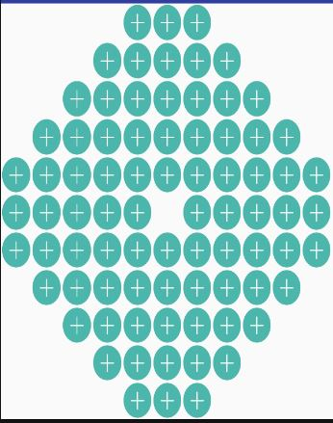
The Game Board
Octagonal board
80 pouches
11 rows, 11 columns

Slide 4



The Players
      Team Duck Team Penguin
      Liability Liability
      15 15 6 15 15 6

Slide 5
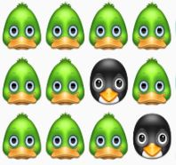
The Strategy
Offense: Earn as many points as possible by building three-stone-arrangements of your team mascot.
Defense: Block your opponents’ attempt at building three-stone-arrangements of their team mascot.
REMEMBER: Your stones stamped with opponent’s mascot are a burden. Get rid of them carefully.
REMEMBER: Miller stones work for either teams.
Don’t let your opponent benefit from them.

Slide 6
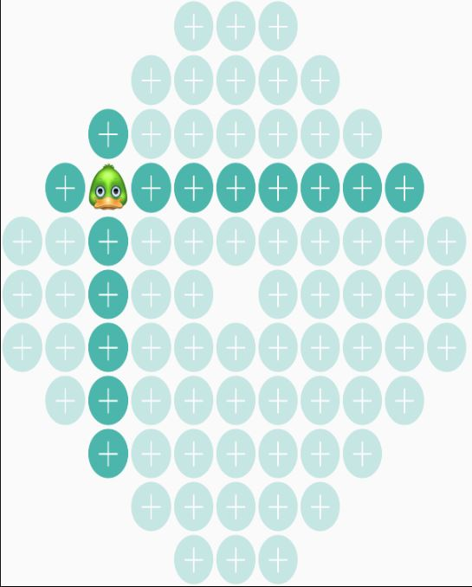
The Rules
Stones can only be placed in the row or column of last placement.
  Exceptions: Stones can be placed anywhere only if
    The game just started
    No available pockets in the row or column of last placement

Slide 7
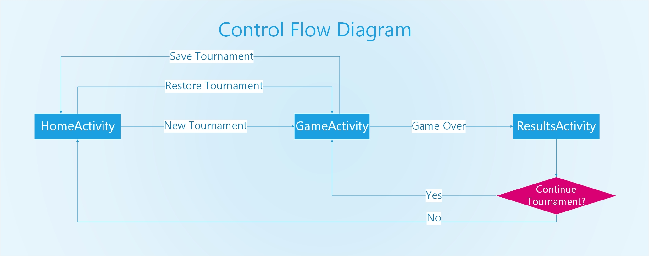
Control Flow Diagram

Slide 8
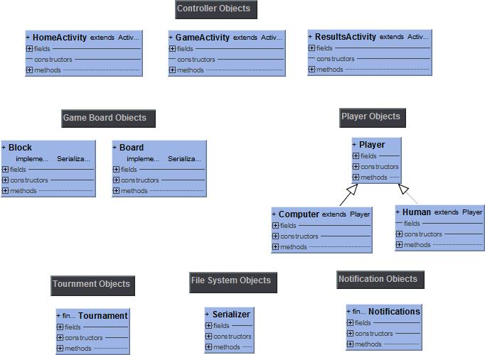
UML Class Diagram

Slide 9
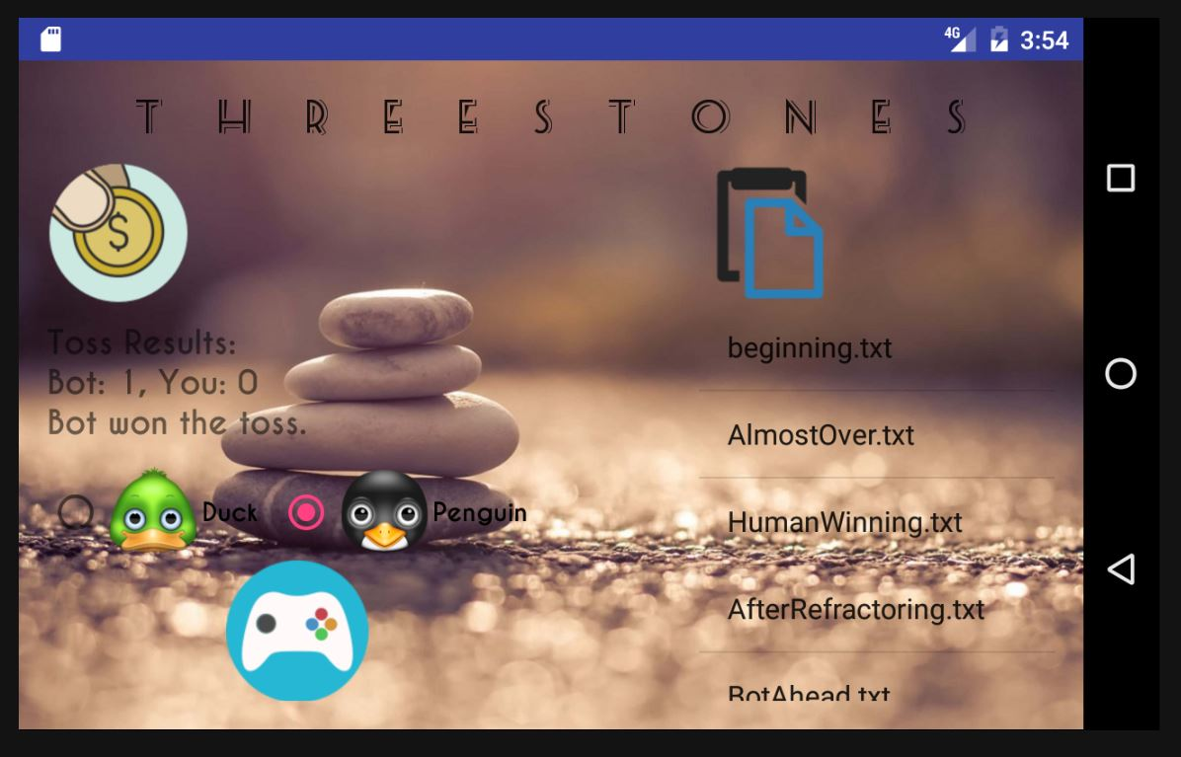
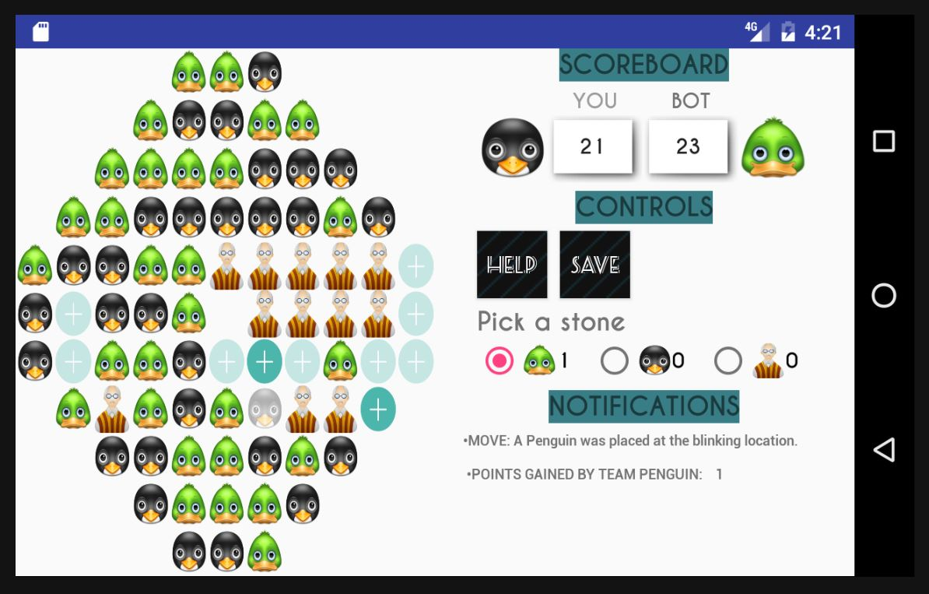
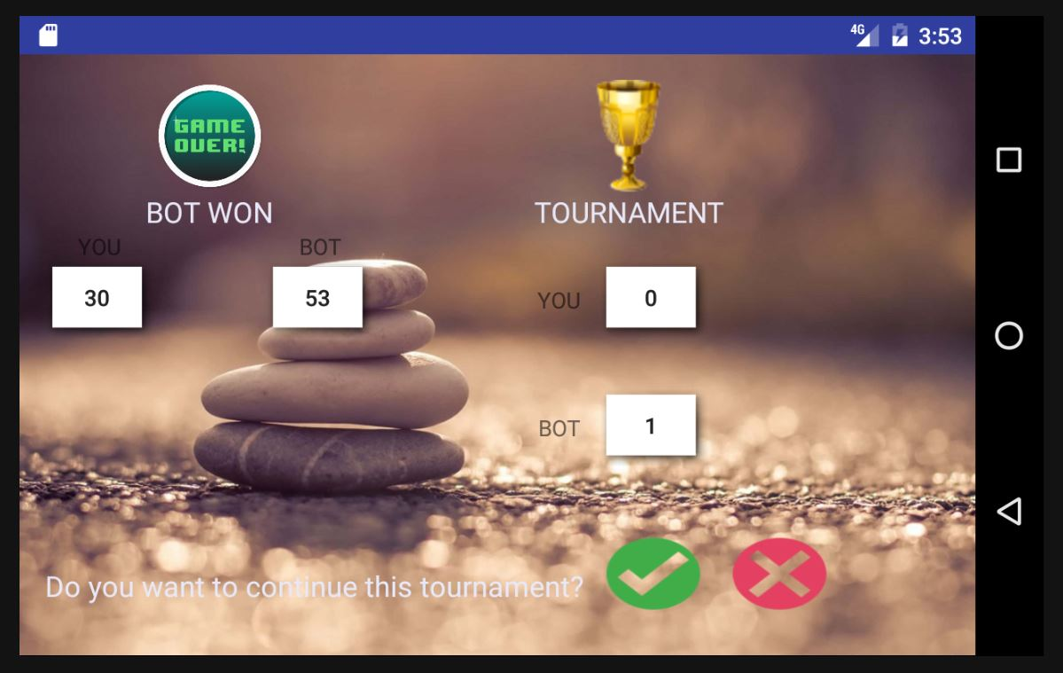
What it looks like

Slide 10
Key Features
Simple intuitive design
  Animations to highlight previous move, recommended move and valid moves
  Notification panel displays logs, warnings and error messages in real time
Computer player algorithms
  Greedy algorithm and best first search to find locally optimum solution

Slide 11
Key Features
Help Mode
  Human Player can ask for move recommendations at any point in game
Serialization
  Save and restore a tournament at any point during the game

Slide 12
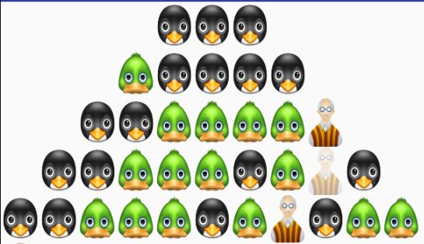
Challenges
Scoring Algorithm

Slide 13
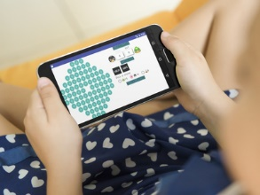
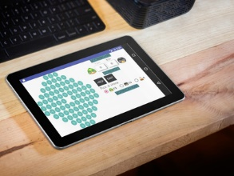
Challenges
Designing an adaptive and responsive interface for devices of various shapes and sizes.
A 5” phone An 11” Tablet

Slide 14
Challenges
And then, some “minor hiccups” on the algorithms for the computer player and help mode, error-free serialization of game, testing every possible scenarios by manually playing the game and pretending to enjoy it – all while developing a second senior project, working 30hrs a week, taking three other courses, and preparing for post-graduation errands.
Nothing crazy.

Slide 15
Demo.Initiate();
Questions = Console.Readline();

